Slide 1
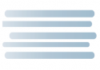





LISTEN AND MATCH THE WEATHER WITH THE COUNTRIES. WRITE THE NUMBERS IN THE SQUARE :
1.
2.
3.
4.
5.
1. ITALY
2.GERMANY
3. IRELAND
4.ENGLAND
5.SPAIN

