Slide 1

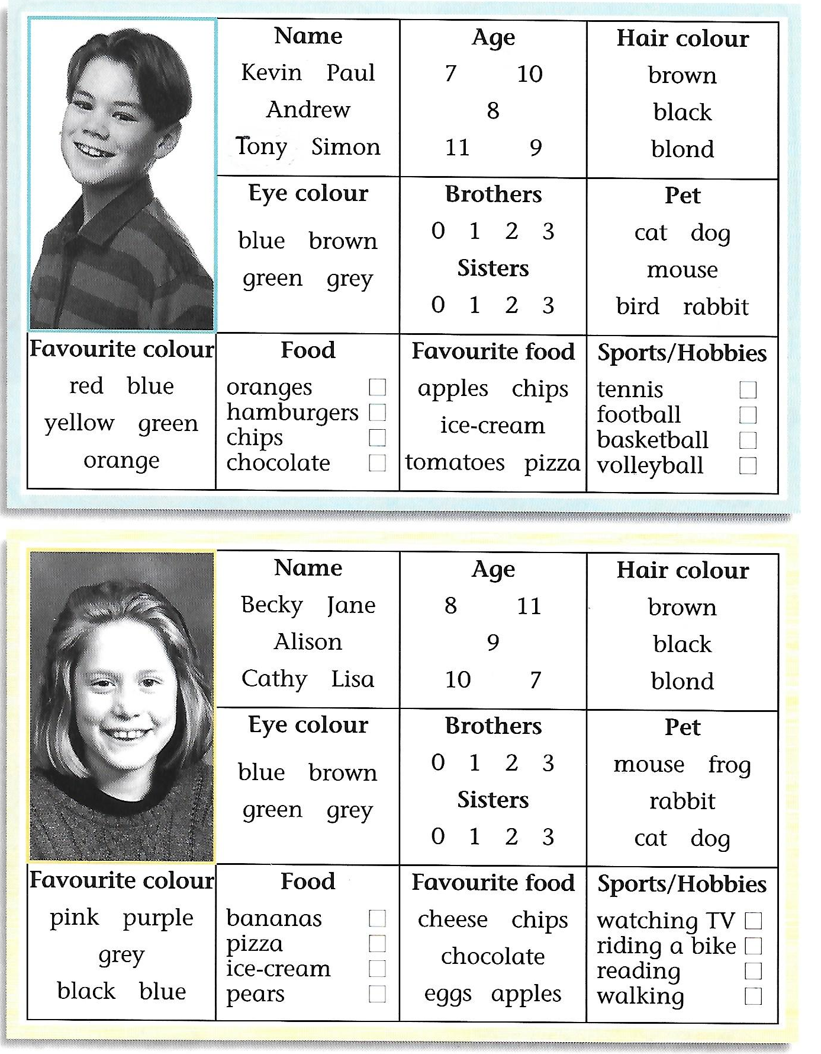
NAME ___________________ CLASS ___________ DATE_____________________
LISTEN AND WRITE

